Slide 1
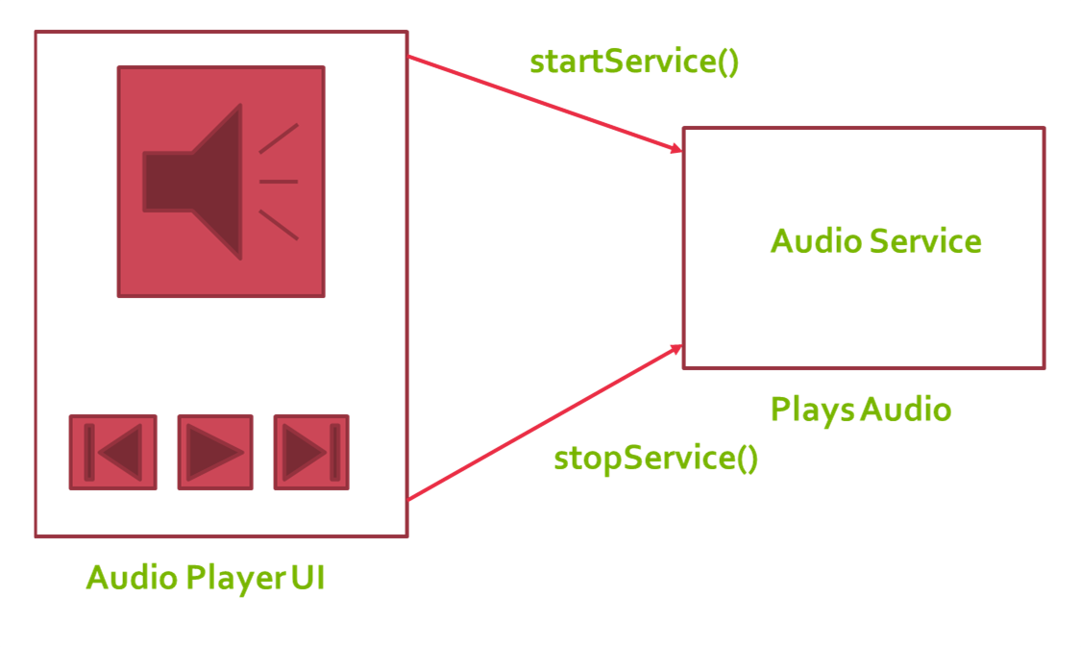
Homework
Implement the following application

